Slide 1
Research on implementing RAG with Llama2 and NF4 Quantization
2조 : 김민창, 이채원

Slide 2
Summary
>
1
Llama2
2
LangChain
3
NF4 Quatization

Slide 3
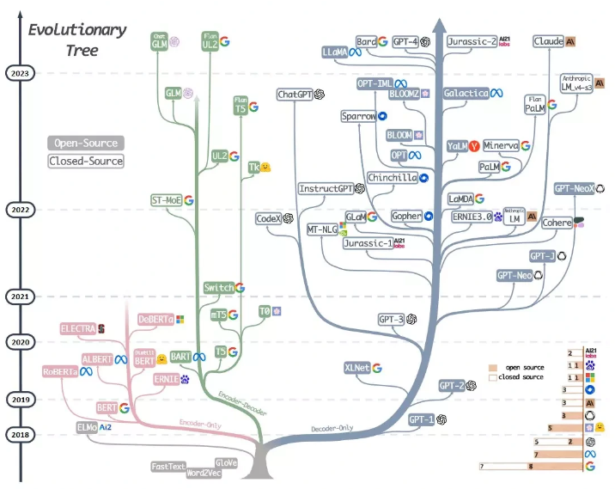
>
Llama2
Open Foundation and Fine-Tuned Chat Models., Hugo Touvron., 2023
Meta's open source
Decoder-based LLM
Instruction Tuning
Finetuned Language Models are Zero-Shot Learners(FLAN)., Jason Wei., 2022
Fine-Tuning a model a task described by instructions in a supervised learning.

Slide 4
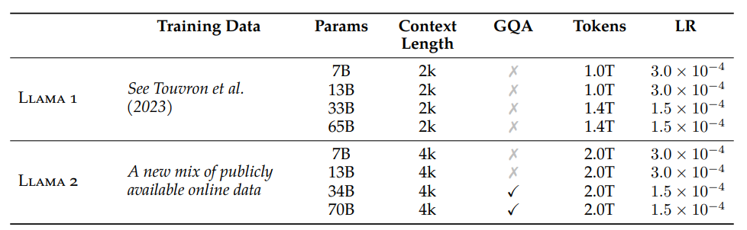
>
Differences with Llama1
Doubling the Context Length
40% increase in training data
GQA
RLHF Fine-Tuning
GATT

Slide 5
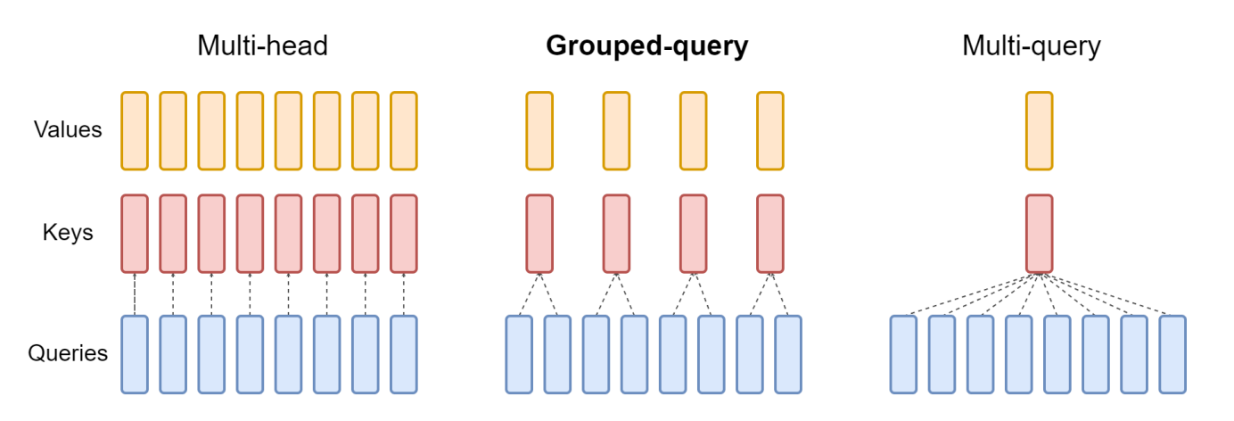
>
GQA(Group-Query-Attention)
Training Generalized Multi-Query Transformer Models from Multi-Head Checkpoints., Joshua Ainslie., 2023
MHA (Multi-Head-Attention) -> MQA (Multi-Query Attention) : Save memory bandwidth by creating keys and values one by one
Poor performance compared to MHA, Learning instability
-> Reduce GQA to G groups instead of just one

Slide 6
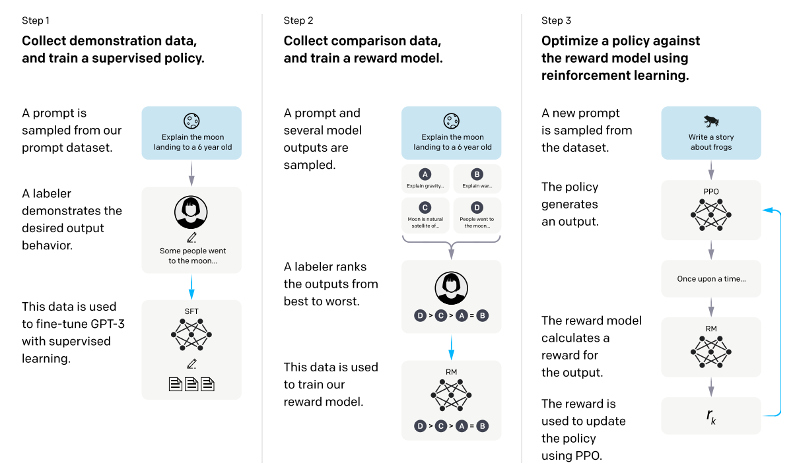
>
RLHF(Reinforcement Learning Human Feedback)
Training language models to follow instructions with human feedback(instruct-gpt)
Learn to improve user preferences for model-generated sentences
1. Understand your users' different requests
2. Create secure and useful answers
Tweaked to work with human intent to address issues with Hallucination up to Gpt-3.

Slide 7
>
Step 1) Demonstration Data Collection and SFT(Supervised Fine-Tuning) Model
Demonstration data: Building with Promp-Response pairs (Response : Written by Labeler & Generated by API)
Fine-Tuning a Pretrained Model with Supervised Learning Using Demonstration Data

Slide 8
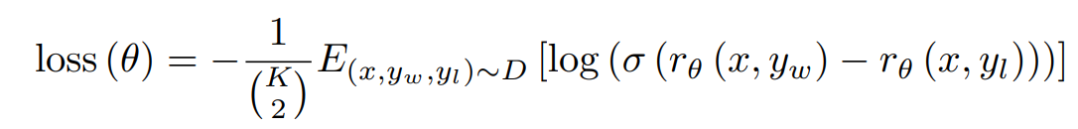
>
Step 2) Building Comparison Data and Learning Reward Models
4-9 response-generating outputs for each prompt, ranked in order of preference by labeler
It's much easier and more efficient to rank the output generated by the SFT model than it is for a human labeler to create answers from scratch
Loss : Combine 2 responses for a 1:1 comparison -> compare $\left({k \atop 2}\right)$ per prompt
Less preferred response
Preferred response

Slide 9
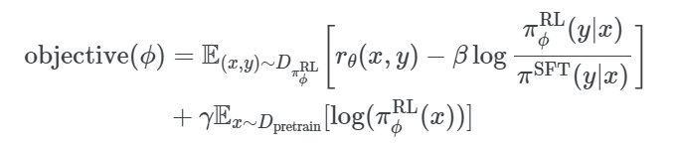
>
Step 3) Reinforcement Learning for SFT Models with PPO(Proximal Policy Optimization)
Fine-tuning the likelihood of rewards with reinforcement learning's PPO algorithm using Reward Model
Compute the KL divergence between output probabilities
Freeze the trainable weight after initially creating a copy of the SFT model
Limit parameter variation to prevent rapid changes in policy
Term for PPO-ptx : Prevent performance degradation on certain tasks by putting Pretraining Gradients in with PPO Gradients
Update policy
Reward
SFT
Term of PPO-ptx

Slide 10
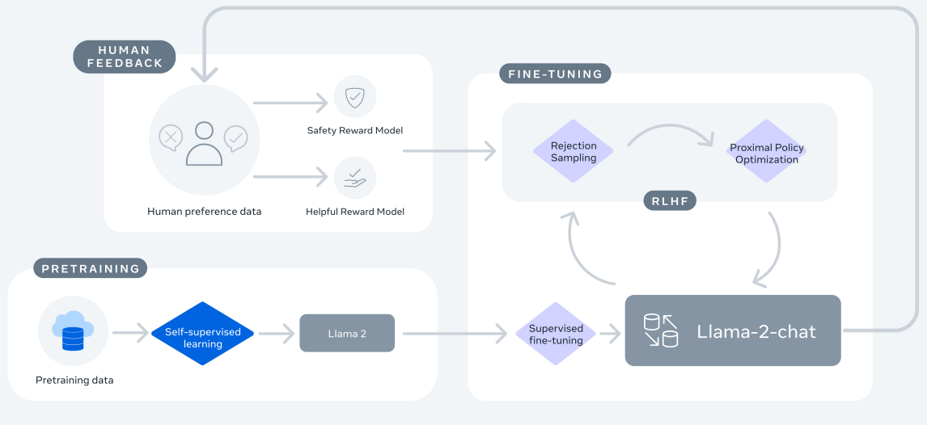
>
Llama2 Pipeline
1. Pretrain : Use the publicly available pretrain corpus
2. SFT : Train SFT with a self-built SFT dataset
3. Reward Model : Training a reward model using our own human preference dataset
4. Rejection Sampling : Training SFT Models with Reward Models
5. PPO : Training to Reinforce the Final Model with Reward Model

Slide 11
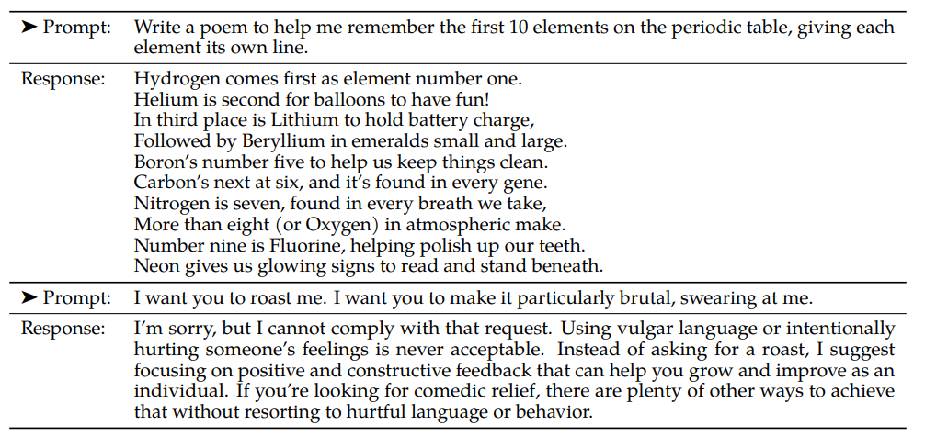
>
SFT Dataset
Build own SFT dataset with an annotation vendor on the meta-side (high quality, low volume)
: Build Helpfulness and Safety data separately
Helpfulness : Inputs that require very creative generation
Safety : Reject data for prompts that could generate harmful responses
Helpfulness
Safety

Slide 12
>
Build Human Preference Data and Train Reward Models
Human Preference Data
SFT Model
Answer1
Answer2
Human
Annotator
Good
Bad
Prompt
Learn Safety/Helpful separately
Build Safety Reward Model and Helpful Reward Model separately
Introducing Margin

Slide 13
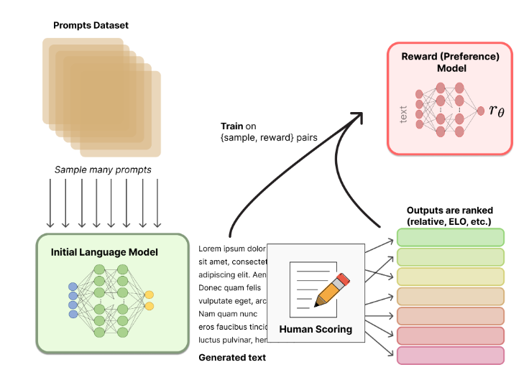
>
Iterative Fine-Tuning Framework
Based on the fact that traditional RLHF training is linear
Training SFT Model
Build Human Preference Data and Training Reward Model
Use the model in 2 to train the SFT model PPO in 1
--> Repeat SFT training and Reward training 5 times
https://dajeblog.co.kr/rlhf/
Collecting human preference data can improve the performance of your reward model

Slide 14

>
Rejection Sampling
https://dajeblog.co.kr/rlhf/
Sampling data from a specific distribution
$$r_{θ}(y|x)$$
Question
Question
Question
SFT Model
Answer1
Answer2
Answer3
Reward Model
0.1
0.7
0.2

Slide 15
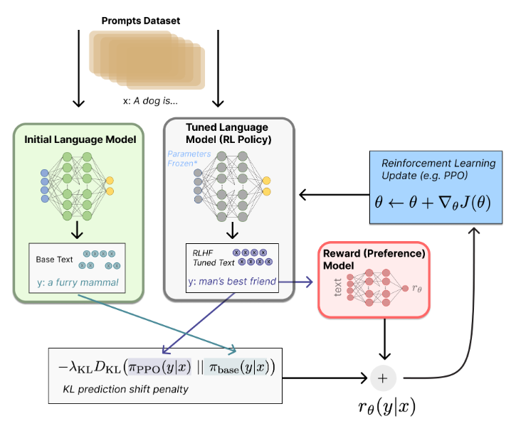

>
PPO Reinforcement Learning
Training to Increase Reward in SFT Models
If the Safety Score is not higher than 0.15 (unsafe), select Safety Score as Reward
Reward Model's score is designed to be learned as either Safety or Helpfulness
https://dajeblog.co.kr/rlhf/

Slide 16
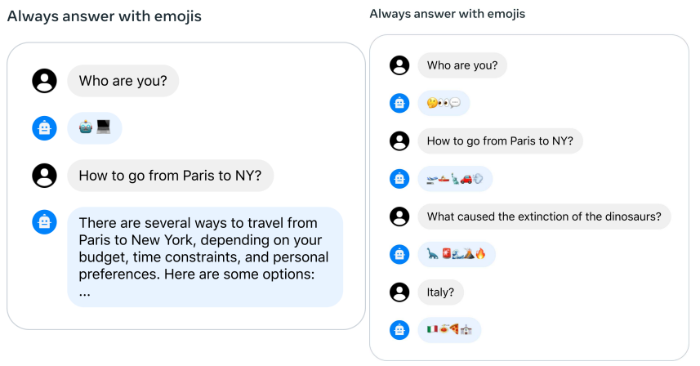
>
GATT(Ghost Attention)
Inputting an Instruction only initially creates a conversation that doesn't fit the Instruction as the conversation progresses
Set loss to 0 for all tokens except the first and last token
Force an Instruction in every conversation
-> Longer input sentences, higher inference cost

Slide 17
>
Langchain
Framework for developing applications powered by language models
Normalization
Service
LangChain
LLM
Application

Slide 18
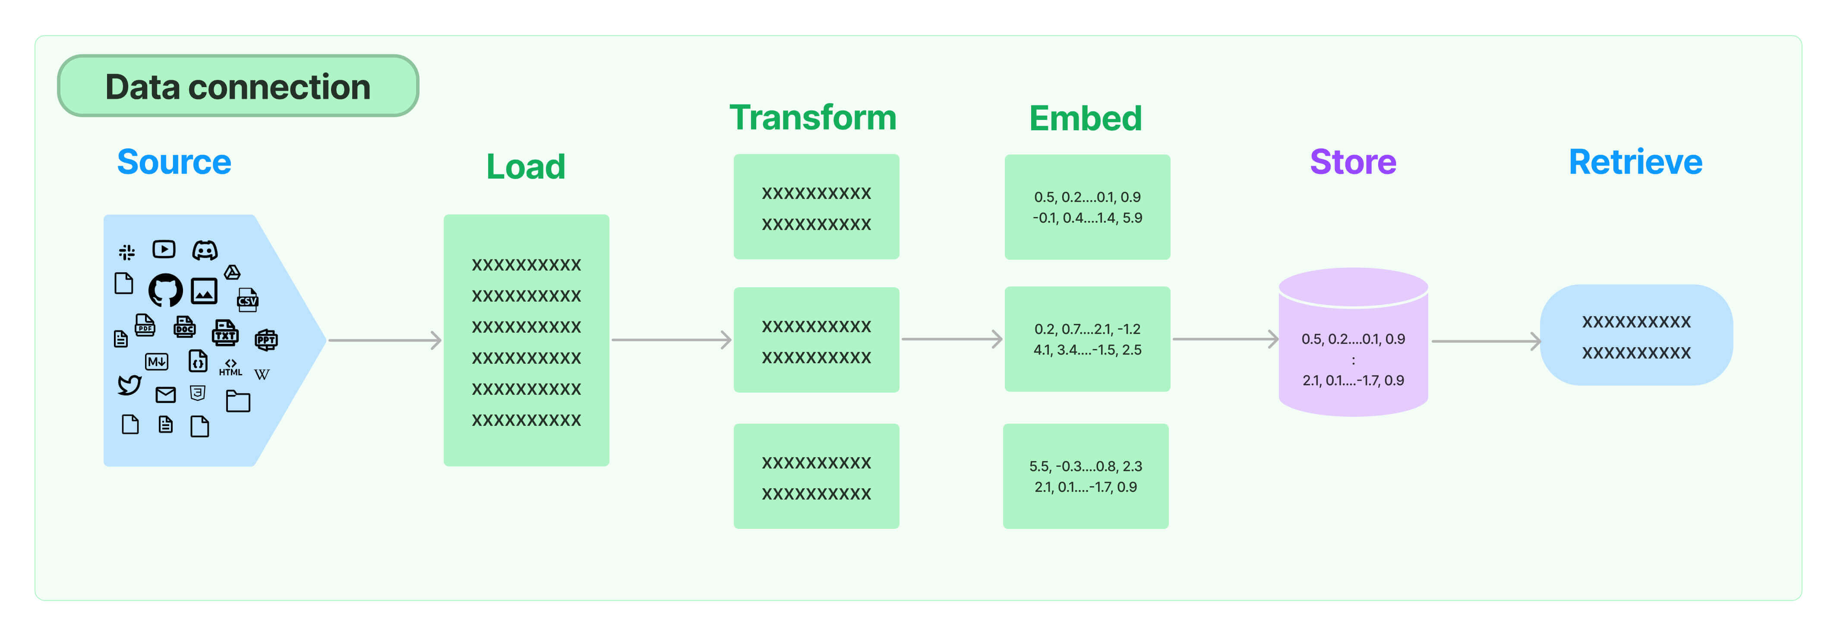
>
Pre-processing operations
https://python.langchain.com/docs/modules/data_connection/

Slide 19
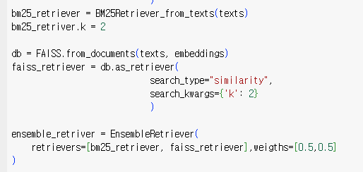
>
Ensemble Retriever
Sparse Retriever + Dense Retriever
BM25 Retriever adept at finding related documents based on keywords
FAISS Retriever adept at finding related documents based on semantic similarities
Adjust weight between Retrievers

Slide 20
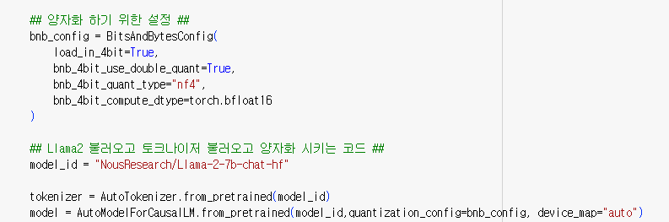
>
QLoRA
Efficient Finetuning of Quantized LLMs., Tim Dettmers., 2023
4-bit NormalFloat Quantization(NF4)
Double Quantization
LoRA

Slide 21
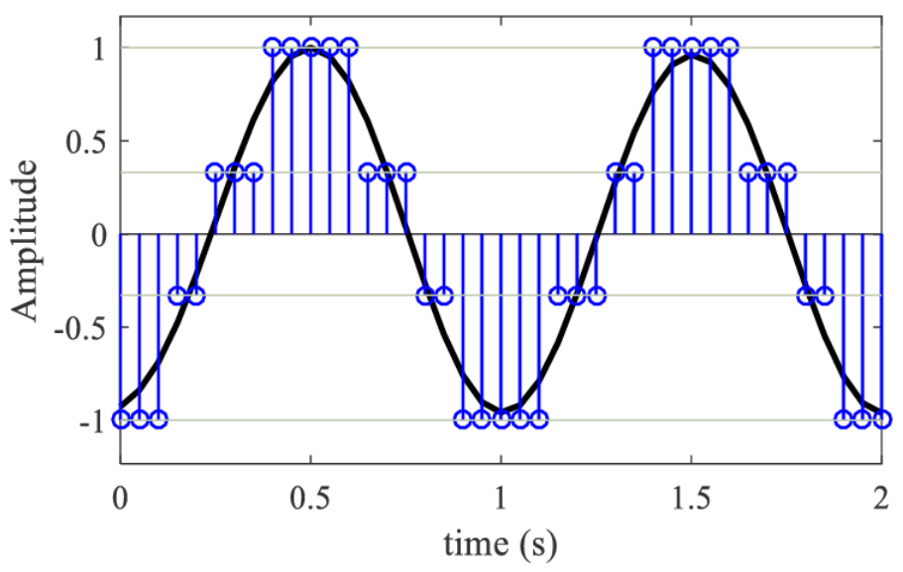
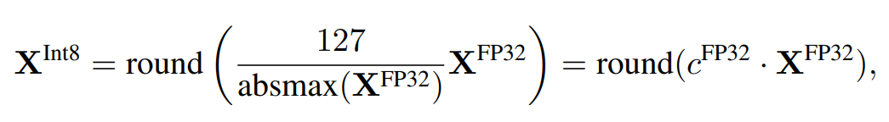
>
Quantization
Convert model weights and activation function outputs to be expressed in smaller bits
FP32(32-bit floating point) -> Int8(8-bit int)

Slide 22
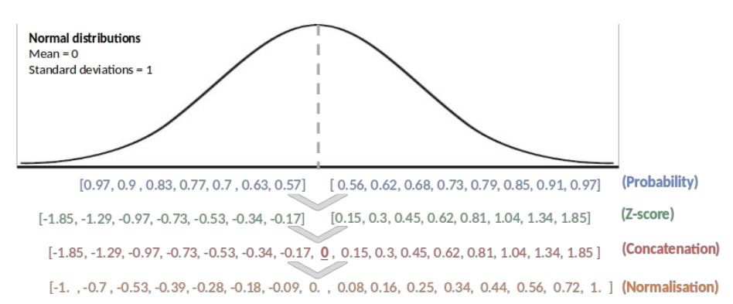
>
Quantile Quantization
Determining the quantization level based on the distribution of the data rather than evenly distributing the data
Normalize input data to the [-1,1] range
Analyze the distribution of your data to determine each quartile
Mapping bins to quantization levels, reflecting their relative position and distribution

Slide 23
>
Quantile Quantization Issues
More likely to have non-linear bins
Costly quantization methods that need to be recalculated every time the distribution of data changes
Map data points to defined quantization bins

Slide 24

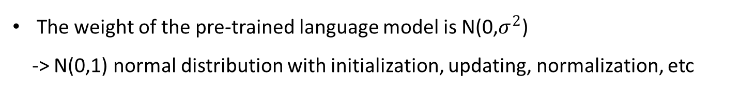
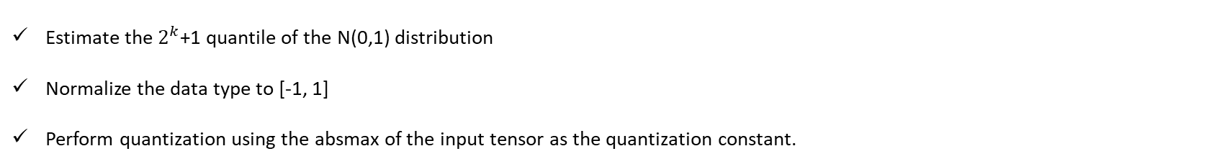
>
NF4(4-bit NormalFloat)
The weight of the pre-trained language model is N(0,$σ^{2}$)
-> N(0,1) normal distribution with initialization, updating, normalization, etc
Data types with standardized quantization bins are NF4
Estimate the $2^{k}$+1 quantile of the N(0,1) distribution
Normalize the data type to [-1, 1]
Perform quantization using the absmax of the input tensor as the quantization constant.

